Slide 1
Bringing the Rotary Action Plan
and Membership Growth to Life in Your Club
Title Page Option

Slide 2
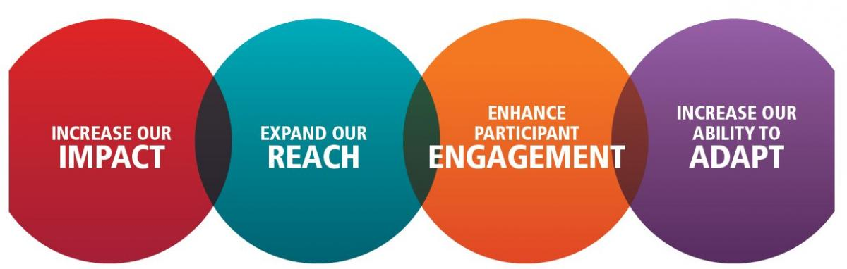
THE ROTARY ACTION PLAN

Slide 3

TOGETHER, we see a world
where PEOPLE unite and take action
to CREATE lasting CHANGE
across the globe, in our communities
and in ourselves.
Title Page Option

Slide 4
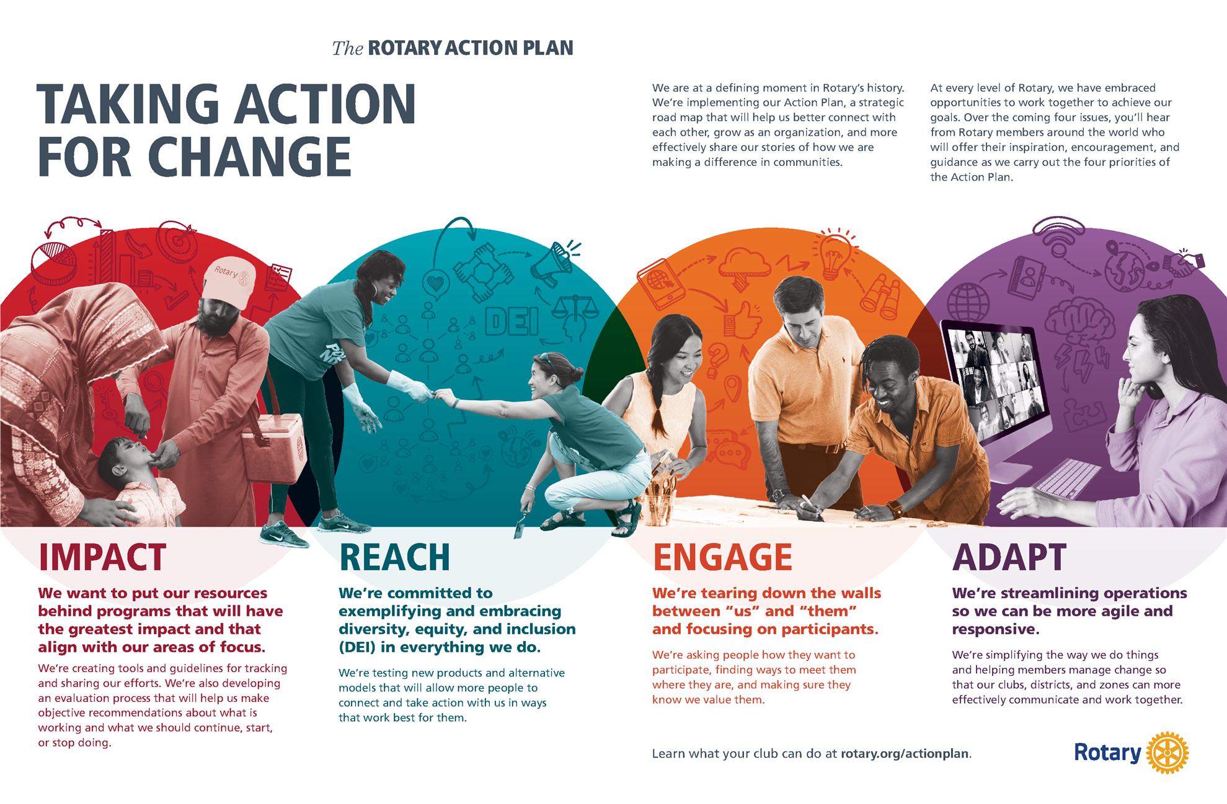

Slide 5
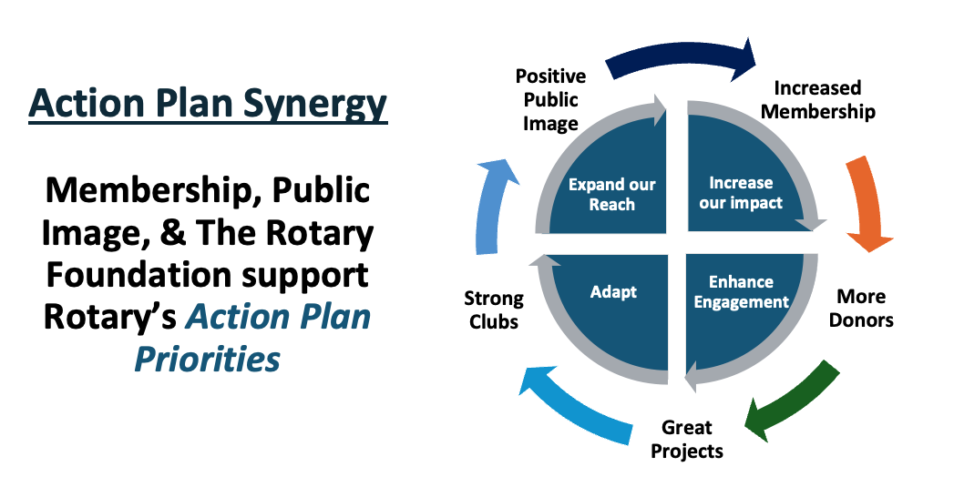

Slide 6
Planning (Adapt)
Build a 3-year Rolling Action Plan
Membership (Reach)
Active Members as of June 30
Service (Engagement)
Members Involved in Service Projects
Rotary Foundation Giving (Impact)
Annual Fund Contributions
Polio Plus Contributions
New Benefactors (Endowment)
ACTION PLAN PRIORITIES
3-Year Rolling Goals

Slide 7
GROWING CLUBS PLAN
81%
71%
83%
Have a Planning Regulary Updated Established Annual
Process for Growth Growth Plans Membership Goals

Slide 8
  Not too short (annual goals)
  Not too long (5-year plan)
  Offers balance (flexibility & forward thinking)
WHY 3-YEAR GOALS?

Slide 9
  Keep it simple
  Prioritize strategies for succession
  Involve everyone
BUILD A PLAN
That fits your club

Slide 10
Get Buy-in From Your Members
Take Your Time
Solicit Feedback (surveys, assemblies, community assessments)
Analyze Results
Identify Actions and Set SMART Goals
Implement and Follow up
BUILDING
YOUR PLAN

Slide 11
Don’t try to do everything
Take a team approach
Break big jobs into smaller pieces
Share the workload and be creative
Match jobs with people’s skills and interests
SETTING YOUR GOALS

Slide 12
REFLECTIONS
FROM A DISTRICT GOVERNOR

Slide 13
Characteristics of Vibrant, Irresistible and Growing Clubs
Club culture is open, welcoming, fun, and warm. You can feel a strong sense of inclusion and belonging starting with a greeter at the door.
Succession plan is in place and the President, President Elect, and President Nominee have been identified.
A visible “CHAMPION” of all things Rotary actively inspires action. Usually the president, but not always.
Clear focus on goals, results, and celebration of success. Actively in pursuit of the Club Excellence Award.
Club is clearly service project focused as opposed to meeting centric focused. Many projects and fund raisers.
Membership growth is top of mind and is talked about and reported on at every meeting.

Slide 14
Characteristics of Vibrant, Irresistible and Growing Clubs
Actively in pursuit of the Rotary Citation (Club Excellence Award)
Active and visible financial support for the Rotary Foundation and masterful at securing TRF grants.
Clearly defined roles with members who share the responsibility for club administration, meeting set up, public image, and programs.
Membership, Public Image, TRF, Technology and Service Project Committees are in place and populated by active members and a chair.
The Four-Way Test, Pledge of Allegiance, reflection, time for humor, and music are common elements of their meetings.
Fun is at the heart of everything they do.
Mark Odland, DG D6360 2024-25

Slide 15
