Slide 1
Rotary Opens Opportunities
2020 – 2021
Rotary District XXXX

Slide 2
Rotary Opens Opportunities
As a participant you will…
Be inspired and ready to act on One Rotary opportunities.
Gain a broader view of opportunities that come through Rotary and Rotaract.
Understand how acting on opportunities and telling stories can help clubs increase membership and result in member retention.
Appreciate how acting on opportunities can lead to increased giving to the Rotary Foundation and Doing Good in the World.
Understand “What’s in it for me” and “What’s in it for others.”

Slide 3
ONE ROTARY STRENGTH IN ONE AREA SUPPORTS THE OTHERS
Membership
Public Image & Awareness
The Rotary Foundation
Increased membership =
More donors/contributors
Positive public image = Increased membership
Great programs/projects = Positive public image
More donors/contributors = Great programs/projects
Notes:
From NC PETS March 2017

Slide 4
Rotary’s Strategic Priorities support Membership, Public Image, & The Rotary Foundation
Increased Membership
More Donors
Great Projects
Positive Public Image
Strong Clubs
Expand our Reach
Increase our impact
Adapt
Enhance Engagement
Notes:
Rotary International and your district have three strategic goals:
Support & Strengthen Clubs
Increase Humanitarian Service
Increase Public Image & Awareness
Why do these matter?
“The time is right to move toward a new vision that brings more people together, increase our image and creates lasting change around the world”

Slide 5
Rotary Opens Opportunities
Rotary’s Vision Statement:
Together, we see a world where people unite and take action to create lasting change —
across the globe,
in our communities,
and in ourselves.

Slide 6
Rotary Opens Opportunities
Setting the Stage
District Governor Remarks
Membership Chair Remarks
The Rotary Foundation Chair Remarks
The Public Image Chair Remarks

Slide 7
Rotary Opens Opportunities
Setting the Stage
District Governor

Slide 8
Rotary Opens Opportunities
Setting the Stage
Membership Chair

Slide 9
Rotary Opens Opportunities
Setting the Stage
The Rotary Foundation Chair

Slide 10
Rotary Opens Opportunities

Slide 11
Rotary Opens Opportunities
Setting the Stage
The Public Image Chair

Slide 12
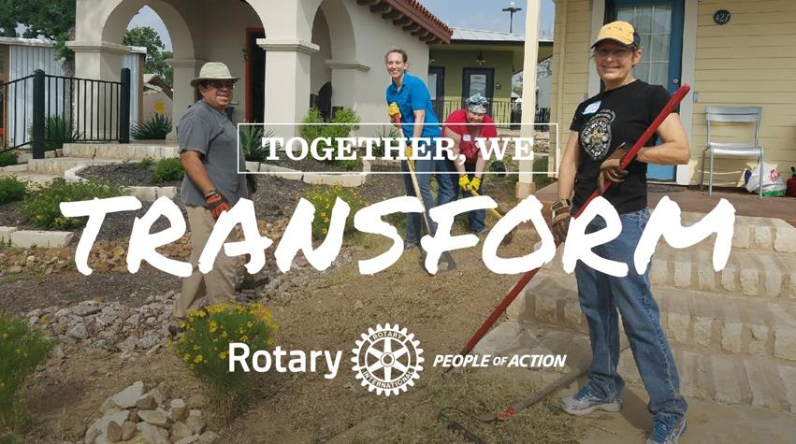
Rotary Opens Opportunities

Slide 13
“We believe that our acts of service, big and small, create opportunities for people who need our help. We also know that every act of service will inspire and change us… Everything we do opens another opportunity for someone, somewhere.”
2020-21 RI President Holger Knaack

Slide 14
Rotary Opens Opportunities
Sharing Ideas

Slide 15
Rotary Opens Opportunities
MOVING TO ACTION

Slide 16
Rotary Opens Opportunities
District Contact List:
(Insert peoples Info here, Name, Email, etc.)

Slide 17
Rotary Opens Opportunities
Please take a few minutes to give us your feedback on this One Rotary Summit.
Give instructions on how to….

Slide 18
Rotary Opens Opportunities
Thanks for
Attending and
Participating!

Slide 19
Rotary Opens Opportunities
Let’s agree to when meeting online:
Mute when
not talking
Turn the camera on
Be fully present
Raise hands to
contribute or comment
Speak and listen
with kindness

Slide 20
Rotary Opens Opportunities

