Slide 1


SERVE TO CHANGE LIVES
2021 – 2022
Rotary District XXXX

Slide 2
SERVE TO CHANGE LIVES
As a participant you will…
  Be excited to ‘Serve to Change Lives’.
  Be inspired and ready to tell the stories of what is accomplished because of Rotary and The Rotary Foundation.
  Understand and be ready to share “What’s in it for me and others because of Rotary.”
  Be inspired and act to increase Rotary’s impact and reach in your community and beyond.
  Understand and support club efforts to increase member engagement.
  Appreciate and support the work of your club in increasing adaptability.

Slide 3
ONE ROTARY
STRENGTH IN ONE AREA SUPPORTS THE OTHERS
Membership
Public Image & Awareness
The Rotary Foundation
Increased membership =
More donors/contributors
Positive public image = Increased membership
Great programs/projects = Positive public image
More donors/contributors = Great programs/projects
Notes:
From NC PETS March 2017

Slide 4
SERVE TO CHANGE LIVES
Rotary’s Vision Statement:
Together, we see a world where people unite and take action to create lasting change —
across the globe,
in our communities,
and in ourselves.

Slide 5
Four
Priorities.
Notes:
It has four priorities. Four. Each priority reflects the input, feedback, and hopes of current and former members, leadership, Rotaractors, alumni, Youth Exchange students, and Rotary staff. In all, we reached out to more than a million people who are connected to Rotary in some way to ensure that our Action Plan priorities are the right ones, and are authentically Rotary. The four priorities are:

Slide 6
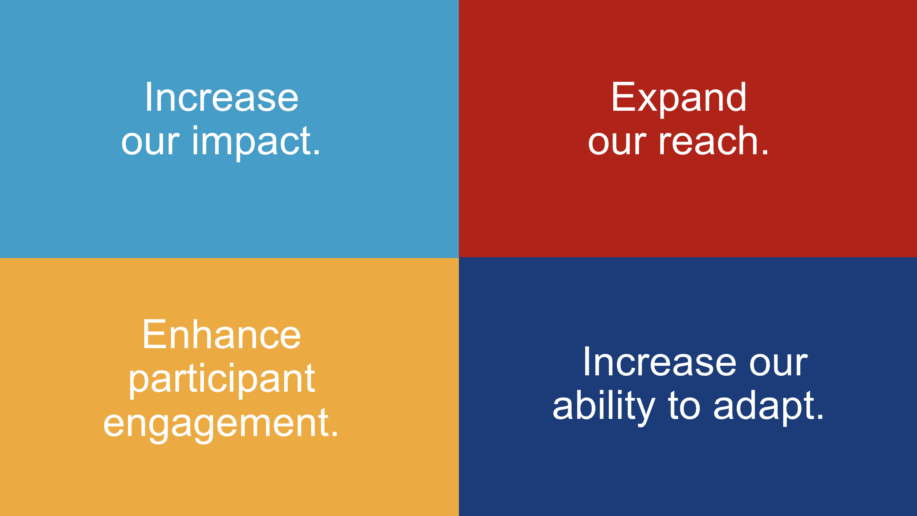
Notes:
Increase our impact;
Expand our reach;
Enhance participant engagement; and,
Increase our ability to adapt.

Slide 7
From Priority to Action.
Notes:
Now let’s look at each one in a little more detail and some of the ways we’ll turn these priorities into action.

Slide 8
Rotary’s Strategic Priorities support
Membership, Public Image, & The Rotary Foundation
Increased Membership
More Donors
Great Projects
Positive Public Image
Strong Clubs
Expand our Reach
Increase our impact
Adapt
Enhance Engagement
Notes:
Rotary International and your district have three strategic goals:
Support & Strengthen Clubs
Increase Humanitarian Service
Increase Public Image & Awareness
Why do these matter?
“The time is right to move toward a new vision that brings more people together, increase our image and creates lasting change around the world”

Slide 9
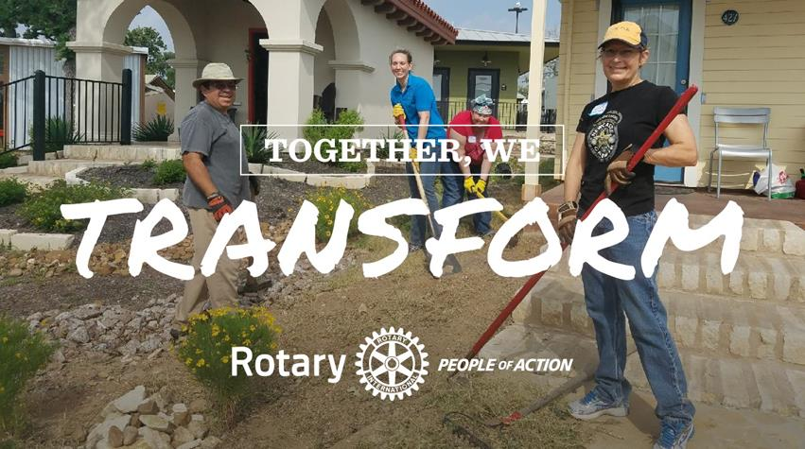
SERVE TO CHANGE LIVES

Slide 10

SERVE TO CHANGE LIVES

Slide 11
SERVE TO CHANGE LIVES
Setting the Stage Panel
Moderator –
Membership –
Rotary Foundation –
Public Image –

Slide 12
SERVE TO CHANGE LIVES
Sharing Ideas

Slide 13

SERVE TO CHANGE LIVES
MOVING TO ACTION

Slide 14
SERVE TO CHANGE LIVES
District Contact List:
(Insert peoples Info here, Name, Email, etc.)

Slide 15
SERVE TO CHANGE LIVES
Please take a few minutes to give us your feedback on this One Rotary Summit.

Slide 16
THANKS FOR ATTENDING
NOW IT’S TIME TO
MOVE TO ACTION!

Slide 17





SERVE TO CHANGE LIVES
Let’s agree to when meeting online:
Mute when
not talking
Turn the camera on
Be fully present
Raise hands to
contribute or comment
Speak and listen
with kindness

Slide 18
SERVE TO CHANGE LIVES

