Slide 1


Bringing the Rotary Action Plan
and Membership Growth
to Life in Your Club

Slide 2

Notes:
The Rotary Action Plan builds upon our past successes and sets our future direction to ensure we continue to grow, unite people, and make lasting impact. The Action Plan is a living document and creates opportunities for clubs and members to take action.

Slide 3

Notes:
The foundation of any Action Plan is the vision articulated here by the power of a clear and consistent vision for the future. TOGETHER PEOPLE CREATE CHANGE. We are people of ACTION.

Slide 4
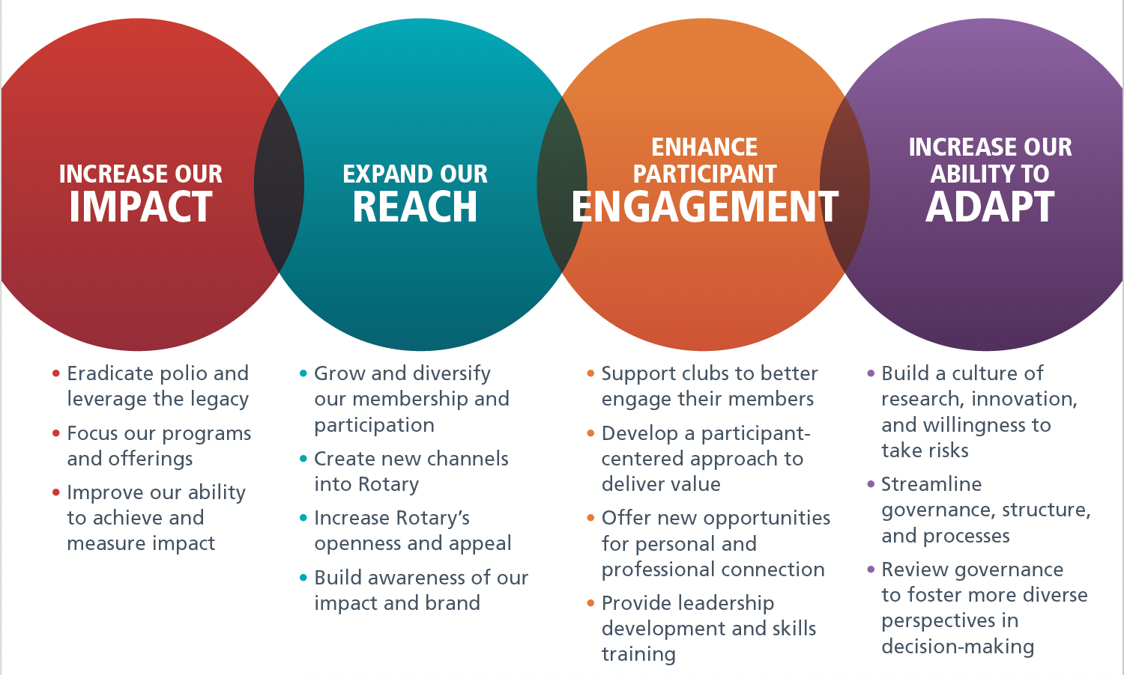
Notes:
The Rotary Action Plan is so much more than a colorful abstract document. It is really all about ACTION.
IMPACT involves development of a strategy to educate our members about the importance of measurable and impactful service projects.
REACH is all about setting goals to grow, collaborate and introduce more people to Rotary.
ENGAGEMENT is about delivering value to current and new members
ADAPT begins with flexibility, innovation, reinvention, efficiency, and continuity.
Remember, we cannot become what we want by remaining what we are.

Slide 5
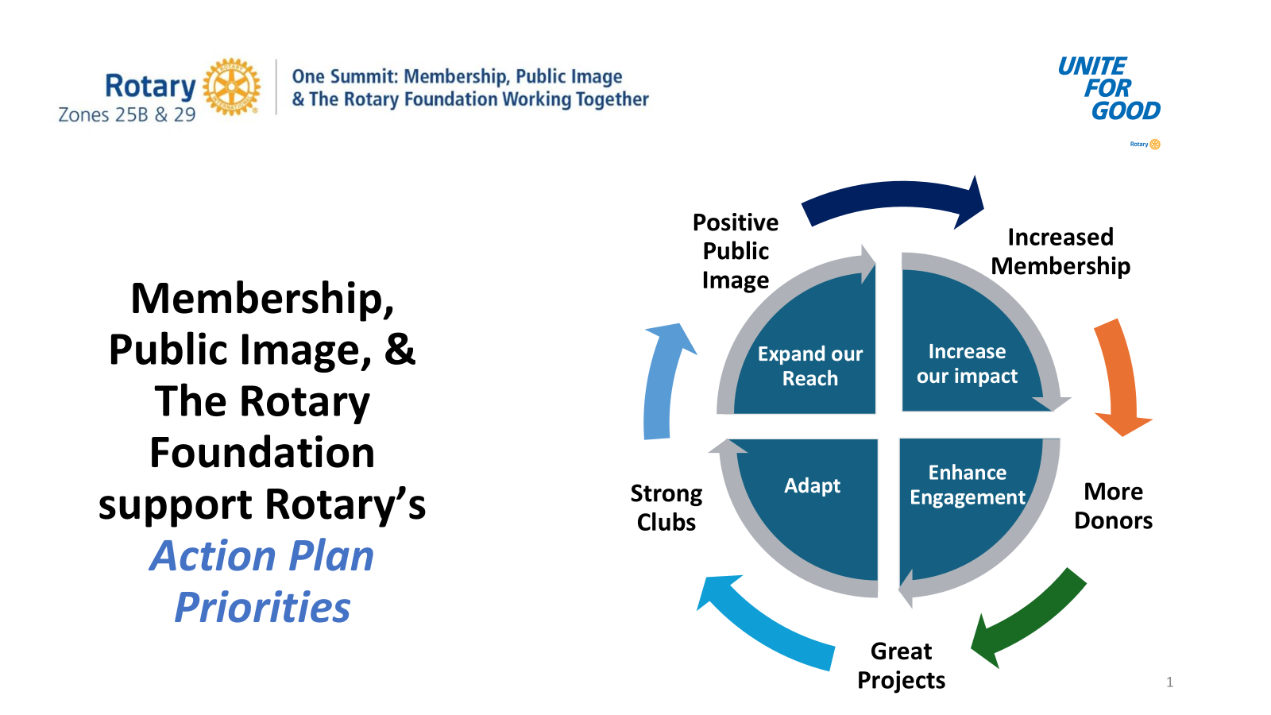
Notes:
How does ONE SUMMIT fit with the Rotary Action Plan? One Summit brings the Action Plan to life by focusing on the value of increased membership. More members means more donors, more projects, stronger clubs, and positive public image. It all fits.

Slide 6
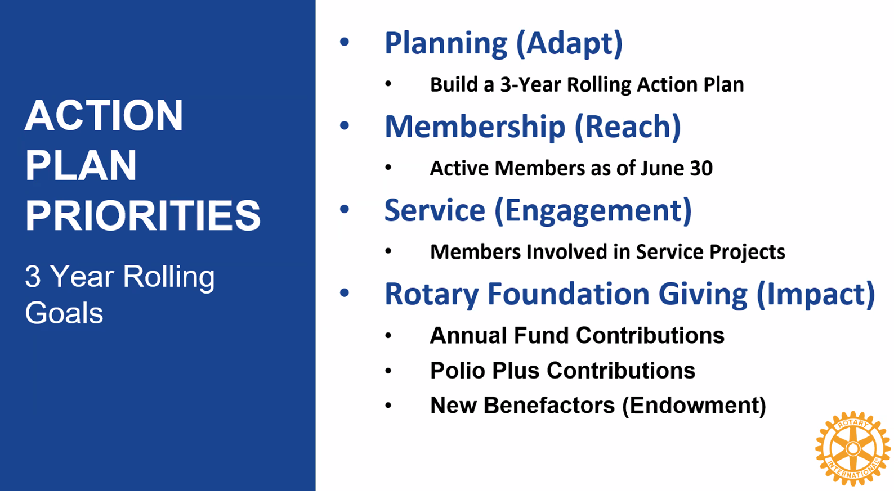

Slide 7
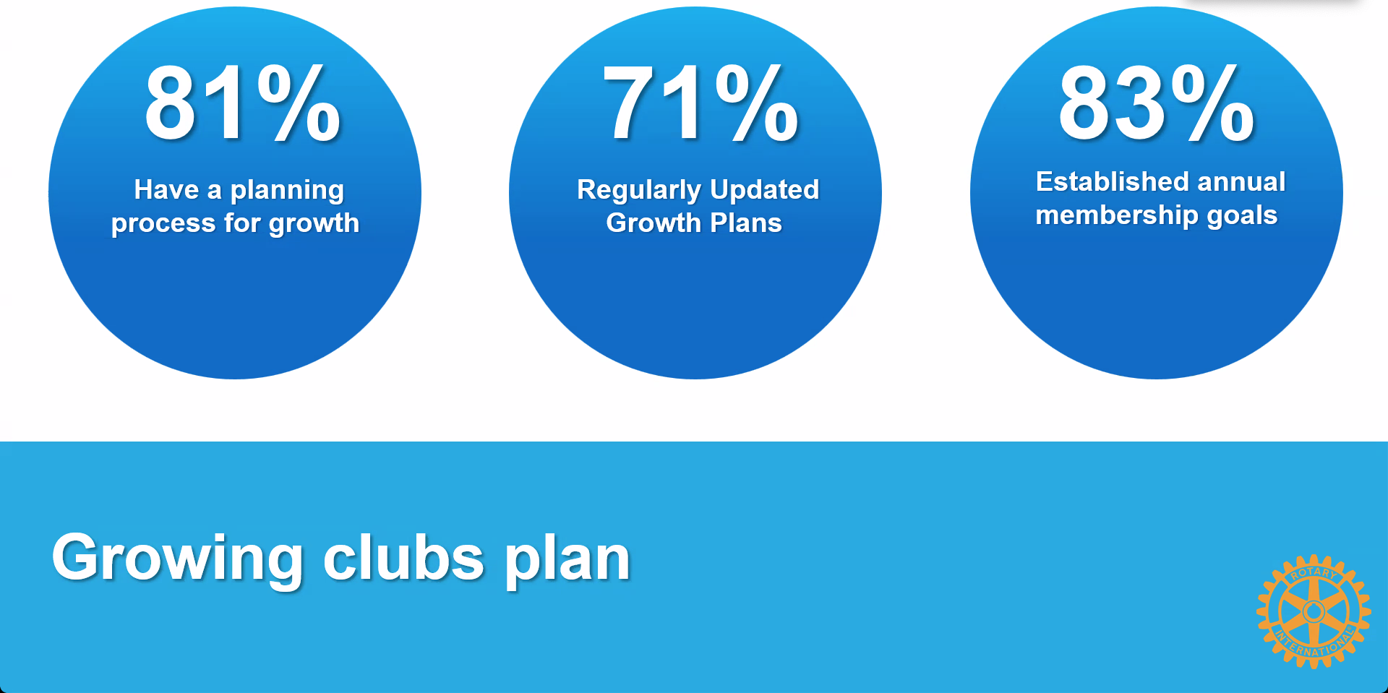
Notes:
Research shows that there are some common themes found in most clubs that are growing. They have a plan for growth that is regularly updated and includes annual membership growth goals.

Slide 8
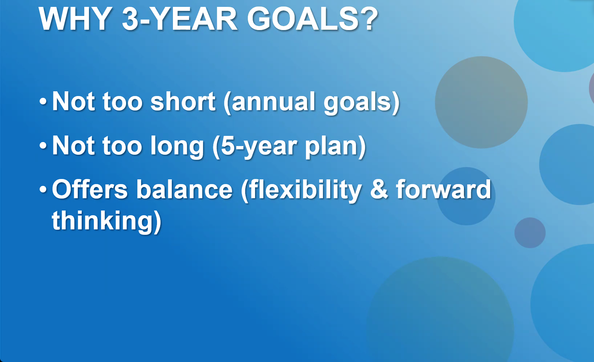

Slide 9
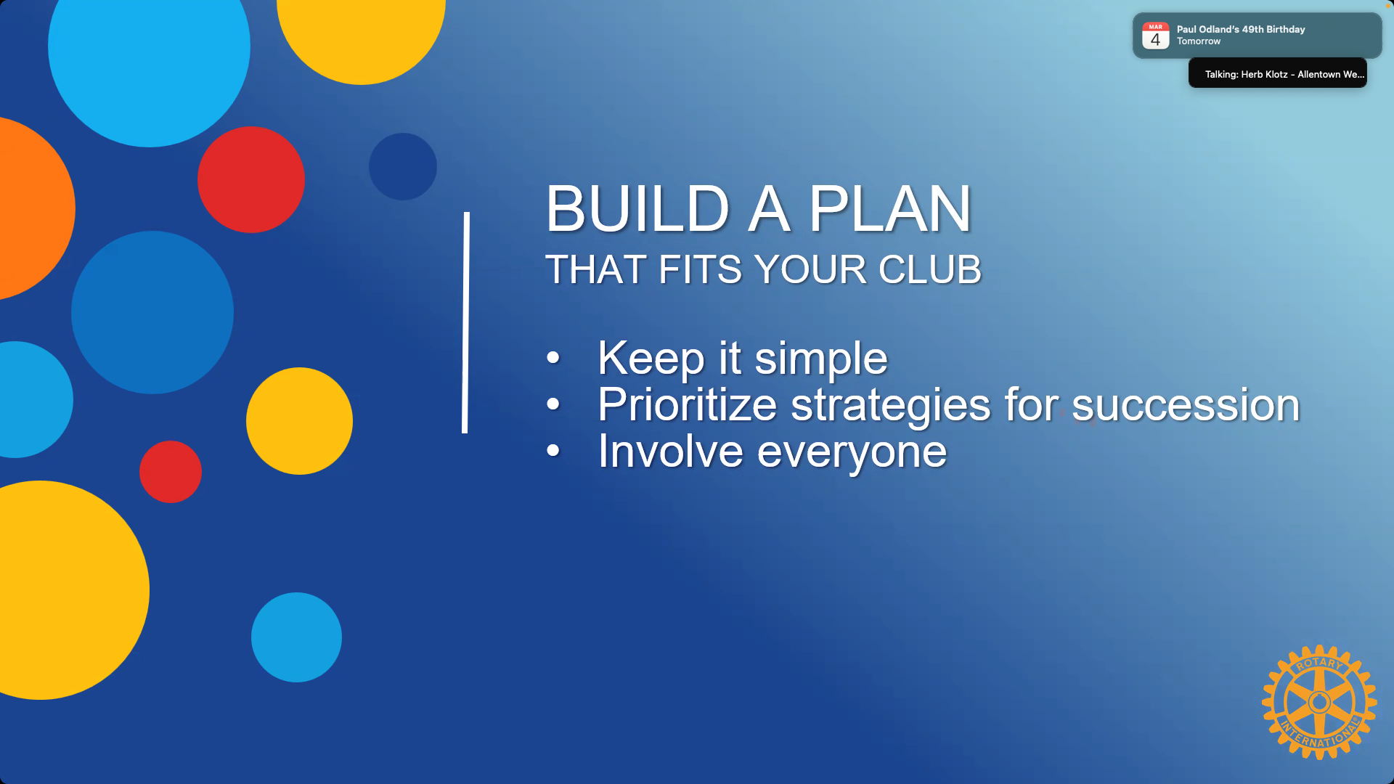

Slide 10
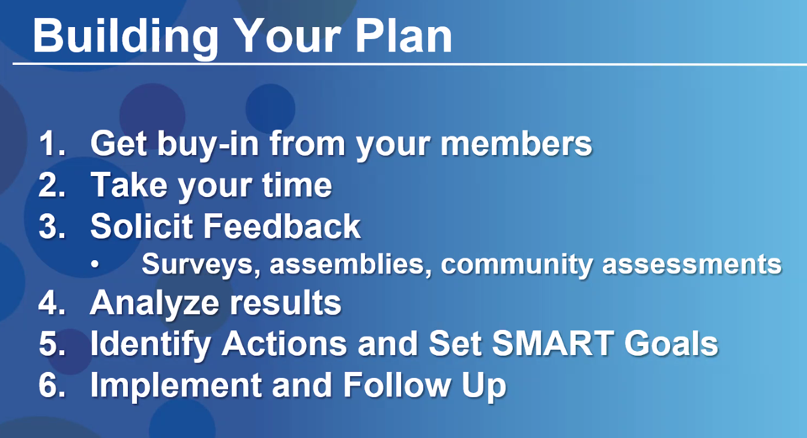

Slide 11
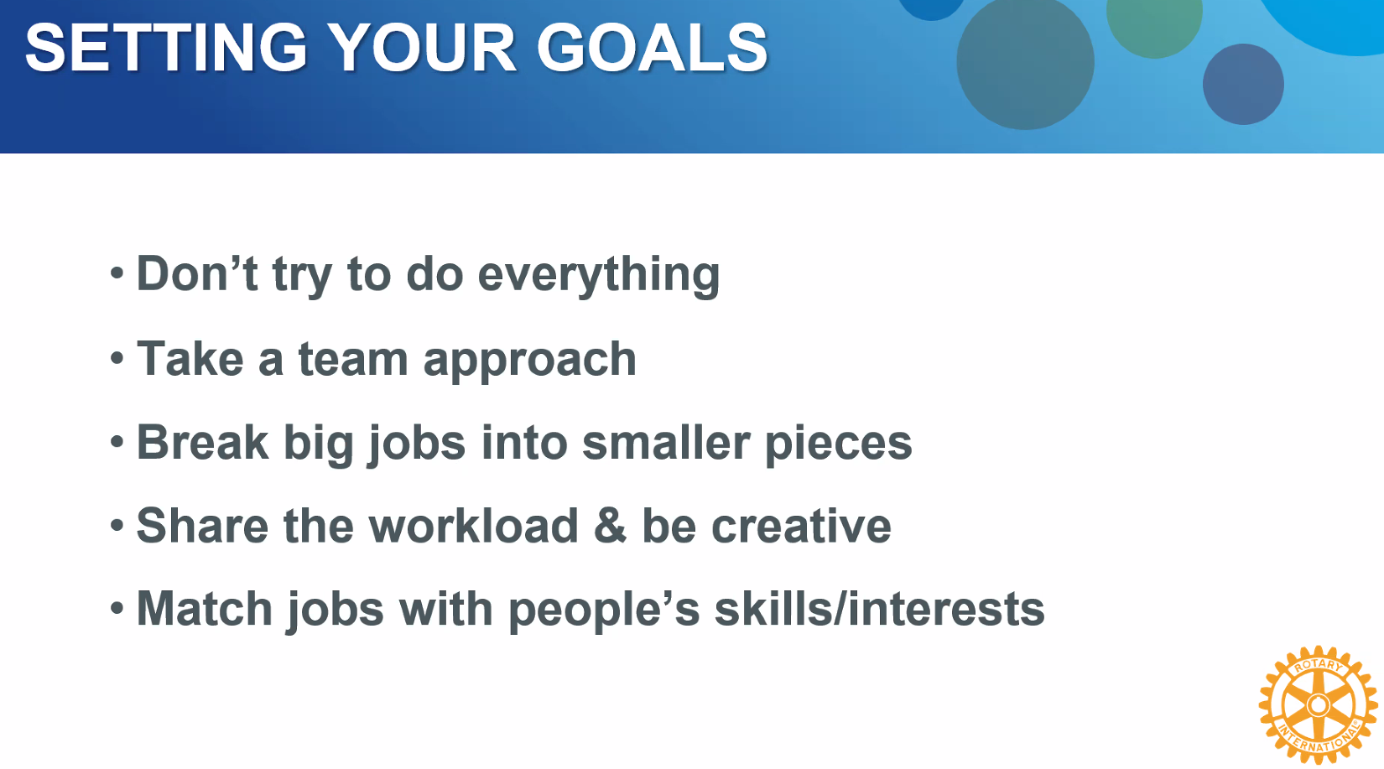

Slide 12
Reflections from a District Governor
Characteristics of Vibrant, Irresistible and Growing Clubs
Club culture is open, welcoming, fun, and warm. You can feel a strong sense of inclusion and belonging starting with a greeter at the door.
Succession plan is in place and the President, President Elect, and President Nominee have been identified.
A visible “CHAMPION” of all things Rotary actively inspires action. Usually the president, but not always.
Clear focus on goals, results, and celebration of success. Actively in pursuit of the Club Excellence Award.
Club is clearly service project focused as opposed to meeting centric focused. Many projects and fund raisers.
Membership growth is top of mind and is talked about and reported on at every meeting.

Slide 13
Reflections from a District Governor
Characteristics of Vibrant, Irresistible and Growing Clubs
Actively in pursuit of the Rotary Citation (Club Excellence Award)
Active and visible financial support for the Rotary Foundation and masterful at securing TRF grants.
Clearly defined roles with members who share the responsibility for club administration, meeting set up, public image, and programs.
Membership, Public Image, TRF, Technology and Service Project Committees are in place and populated by active members and a chair.
The Four-Way Test, Pledge of Allegiance, reflection, time for humor, and music are common elements of their meetings.
Fun is at the heart of everything they do.
Mark Odland, DG D6360 2024-25

Slide 14


