Slide 1


WELCOME
TO
District ____’s ONE SUMMIT
Membership
Public Image
The Rotary Foundation
Working Together to Support Your Club’s Action Plan

Slide 2
As a participant you will…
…be considering ways of Bringing the Rotary Action Plan and Membership Growth to Life in Your Club.
…be discussing a Scenario and recording ideas.
…take home a One Summit Toolkit
…share and hear ideas from today’s One Summit in a Wrap-up Session and focus on what you will take back to your club

Slide 3
What to expect today…
Welcome and Overview
Bringing the Rotary Action Plan and Membership Growth to Life in Your Club
A Break and Something Fun
Scenario Discussion and Ideas
Wrap-Up
Notes:
Now let’s look at each one in a little more detail and some of the ways we’ll turn these priorities into action.

Slide 4
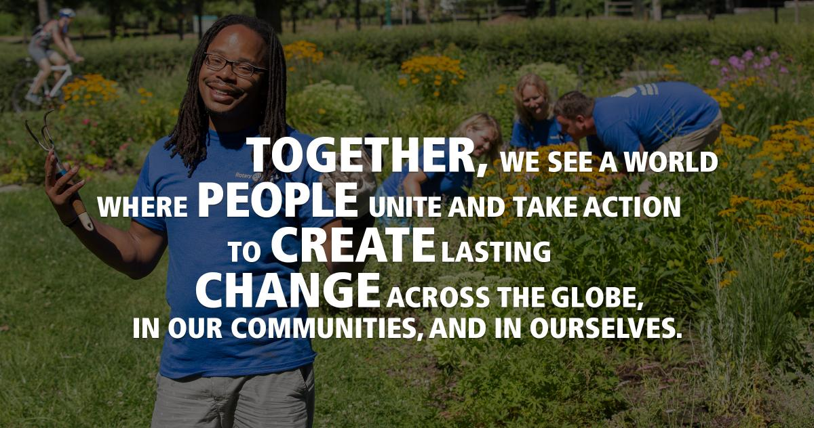
Rotary International’s Vision Statement

Slide 5
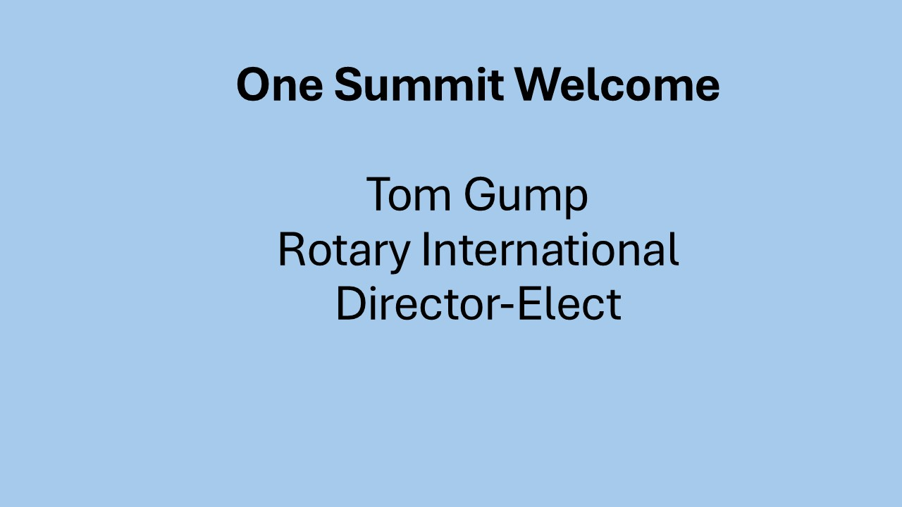

Slide 6
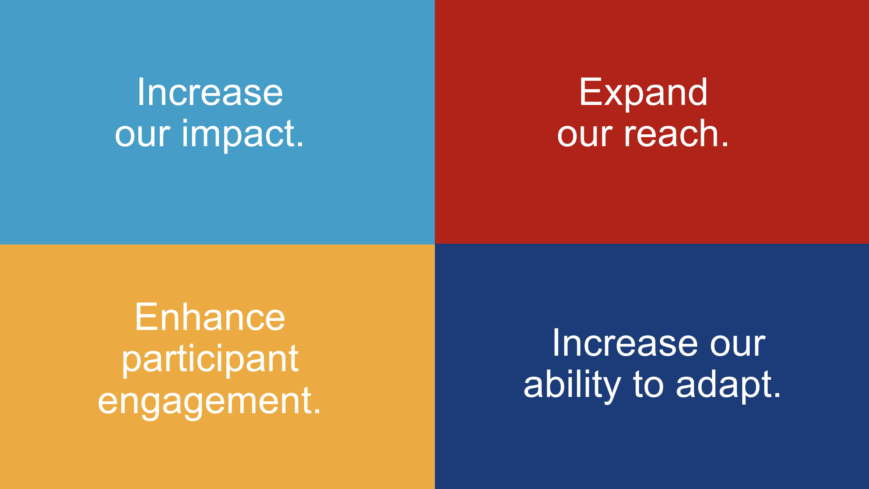
Rotary’s Action Plan Priorities
Notes:
Increase our impact;
Expand our reach;
Enhance participant engagement; and,
Increase our ability to adapt.

Slide 7
Positive Public Image
Increased Membership
Membership, Public Image, & The Rotary Foundation support Rotary’s Action Plan Priorities
Expand our Reach
Increase our impact
Strong Clubs
Adapt
Enhance Engagement
More Donors
Great Projects
Notes:
Rotary International and your district have three strategic goals:
Support & Strengthen Clubs
Increase Humanitarian Service
Increase Public Image & Awareness
Why do these matter?
“The time is right to move toward a new vision that brings more people together, increase our image and creates lasting change around the world”

Slide 8
Bringing the Rotary Action Plan
and Membership Growth
to Life in Your Club

Slide 9

Notes:
The Rotary Action Plan builds upon our past successes and sets our future direction to ensure we continue to grow, unite people, and make lasting impact. The Action Plan is a living document and creates opportunities for clubs and members to take action.

Slide 10

Notes:
The foundation of any Action Plan is the vision articulated here by the power of a clear and consistent vision for the future. TOGETHER PEOPLE CREATE CHANGE. We are people of ACTION.

Slide 11
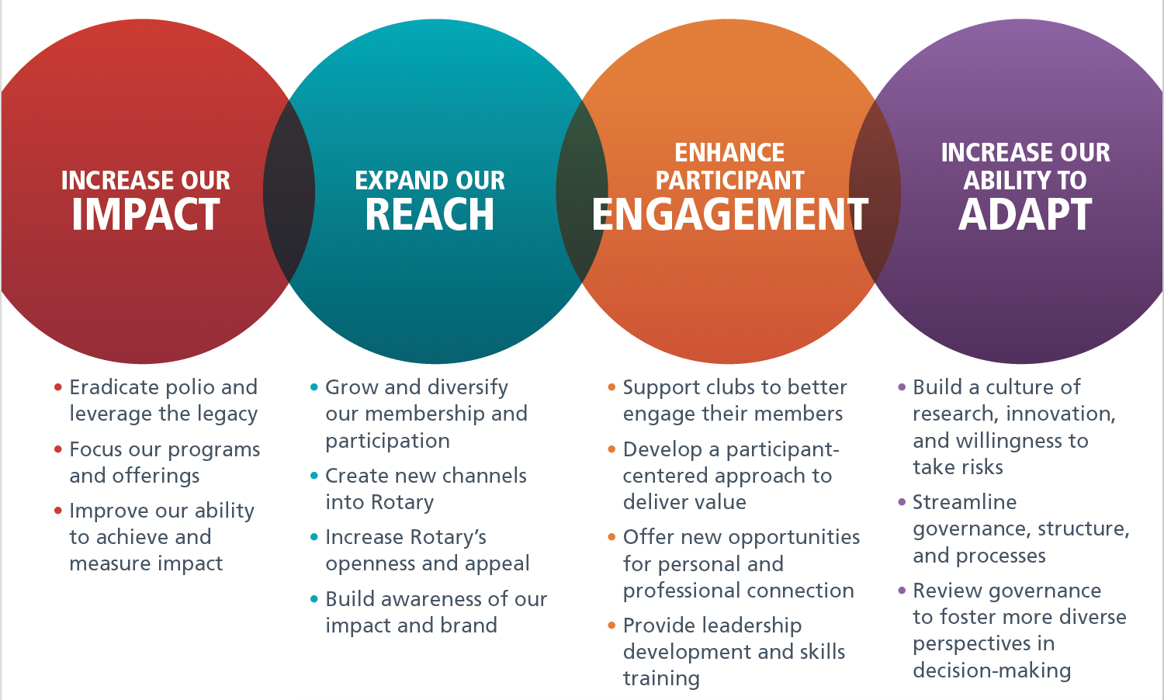
Notes:
The Rotary Action Plan is so much more than a colorful abstract document. It is really all about ACTION.
IMPACT involves development of a strategy to educate our members about the importance of measurable and impactful service projects.
REACH is all about setting goals to grow, collaborate and introduce more people to Rotary.
ENGAGEMENT is about delivering value to current and new members
ADAPT begins with flexibility, innovation, reinvention, efficiency, and continuity.
Remember, we cannot become what we want by remaining what we are.

Slide 12
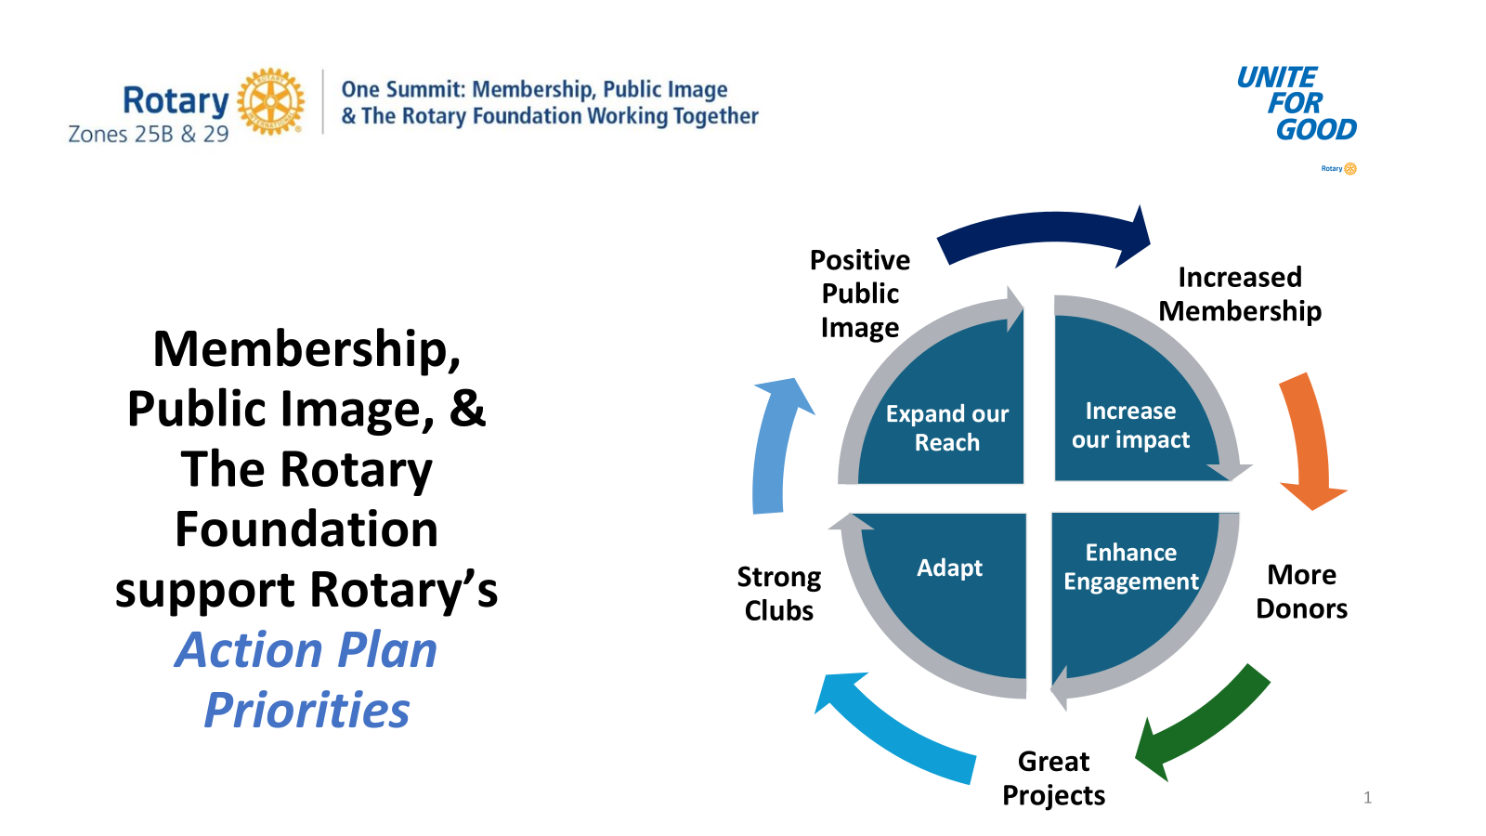
Notes:
How does ONE SUMMIT fit with the Rotary Action Plan? One Summit brings the Action Plan to life by focusing on the value of increased membership. More members means more donors, more projects, stronger clubs, and positive public image. It all fits.

Slide 13
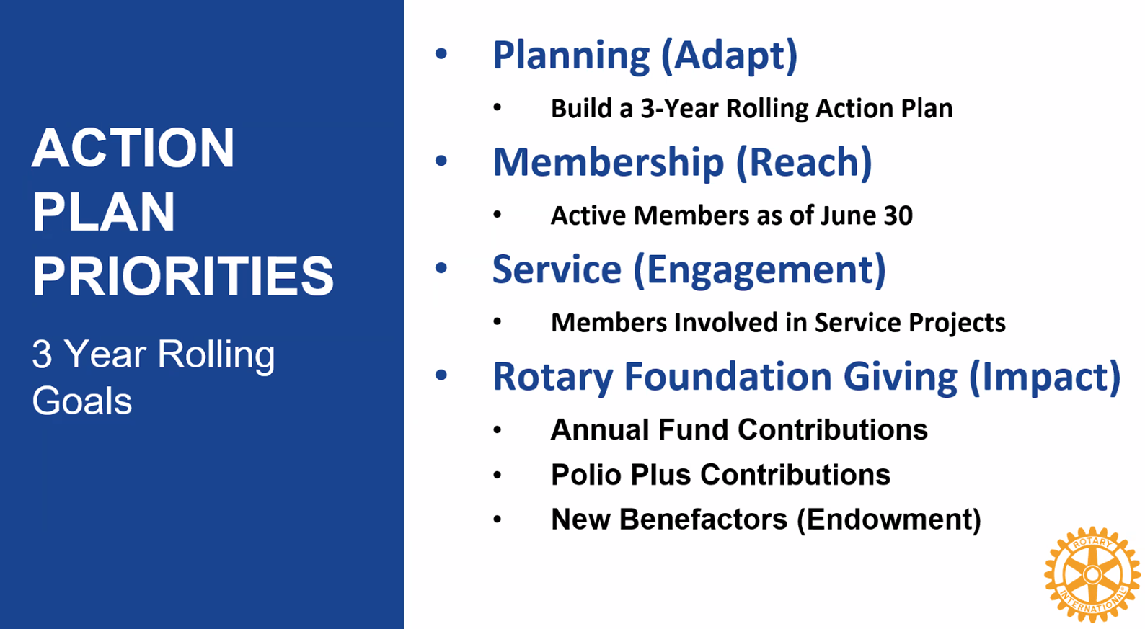

Slide 14
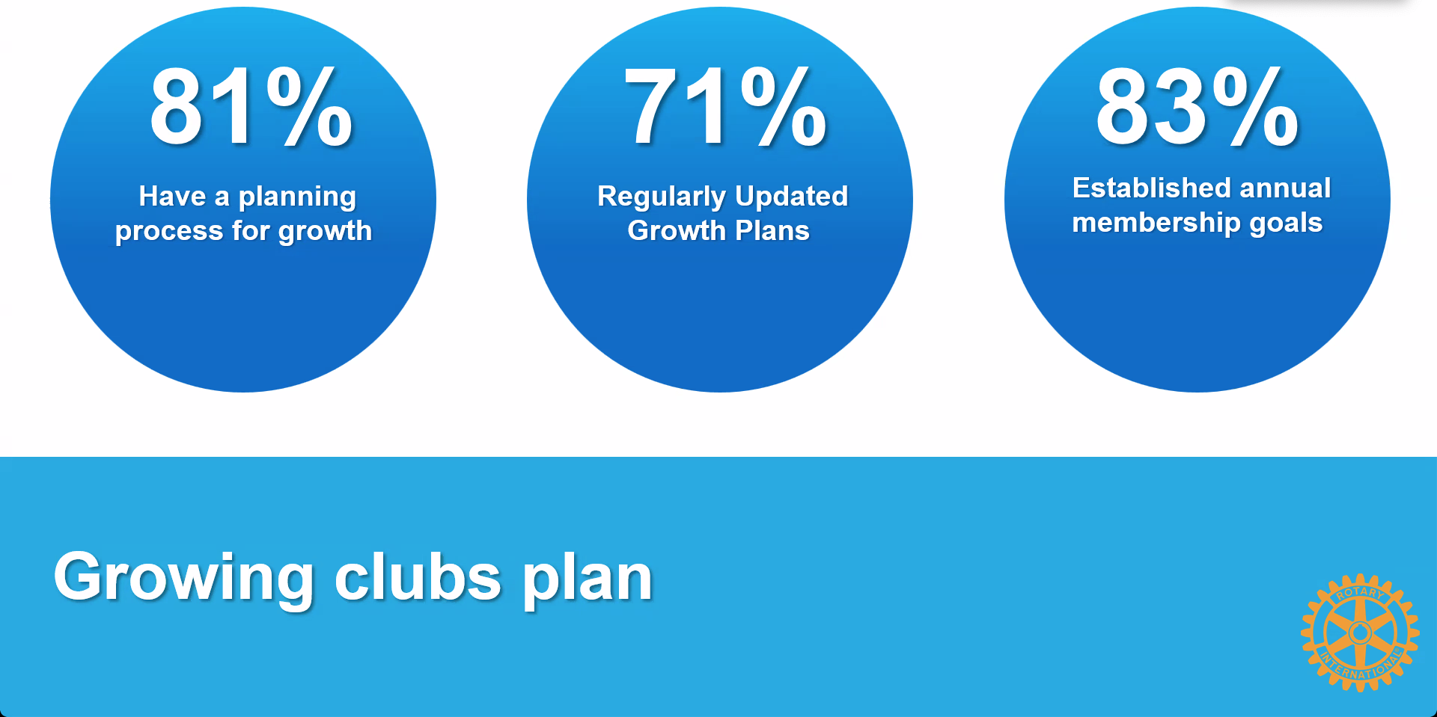
Notes:
Research shows that there are some common themes found in most clubs that are growing. They have a plan for growth that is regularly updated and includes annual membership growth goals.

Slide 15
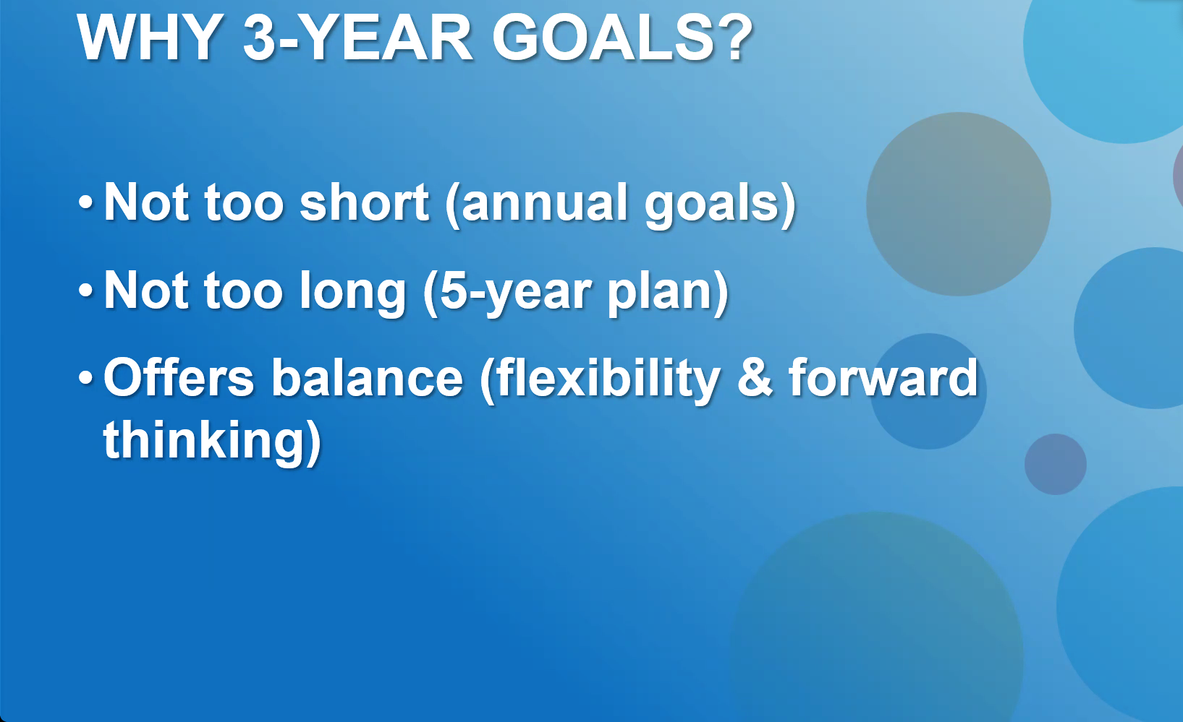

Slide 16
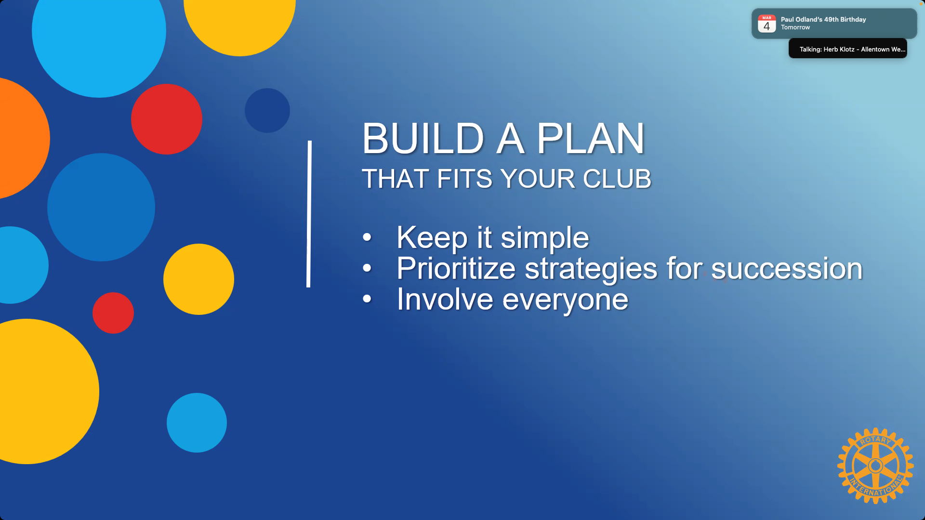

Slide 17
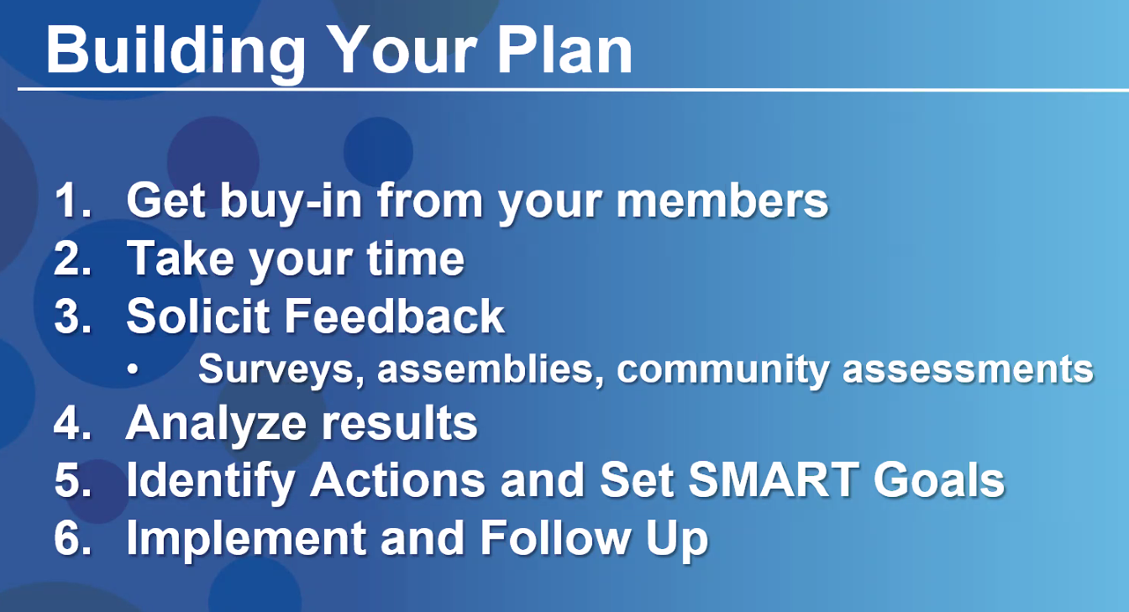

Slide 18
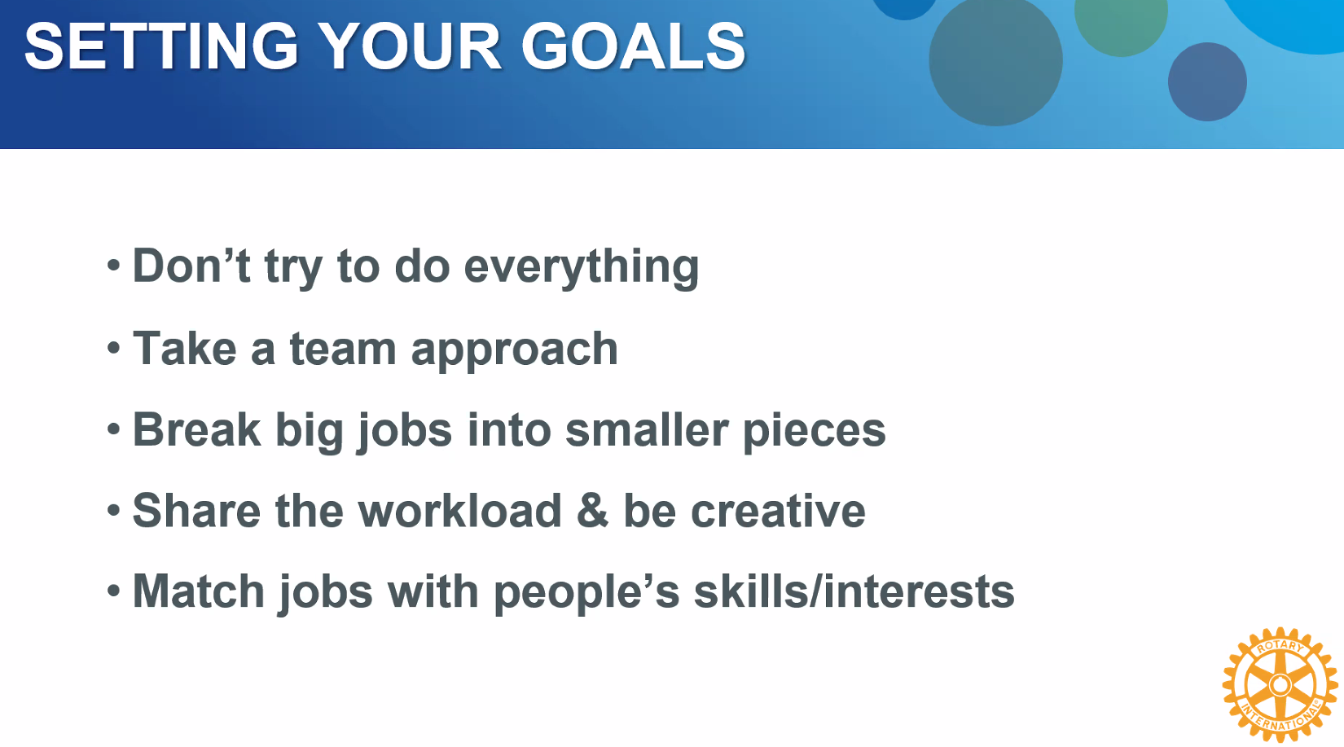

Slide 19
Reflections from a District Governor
Characteristics of Vibrant, Irresistible and Growing Clubs
Club culture is open, welcoming, fun, and warm. You can feel a strong sense of inclusion and belonging starting with a greeter at the door.
Succession plan is in place and the President, President Elect, and President Nominee have been identified.
A visible “CHAMPION” of all things Rotary actively inspires action. Usually the president, but not always.
Clear focus on goals, results, and celebration of success. Actively in pursuit of the Club Excellence Award.
Club is clearly service project focused as opposed to meeting centric focused. Many projects and fund raisers.
Membership growth is top of mind and is talked about and reported on at every meeting.

Slide 20
Reflections from a District Governor
Characteristics of Vibrant, Irresistible and Growing Clubs
Actively in pursuit of the Rotary Citation (Club Excellence Award)
Active and visible financial support for the Rotary Foundation and masterful at securing TRF grants.
Clearly defined roles with members who share the responsibility for club administration, meeting set up, public image, and programs.
Membership, Public Image, TRF, Technology and Service Project Committees are in place and populated by active members and a chair.
The Four-Way Test, Pledge of Allegiance, reflection, time for humor, and music are common elements of their meetings.
Fun is at the heart of everything they do.
Mark Odland, DG D6360 2024-25

Slide 21


Slide 22
BREAK
and
FUN

Slide 23

A Scenario
Ideas! Ideas!

Slide 24

WRAP-UP
Learning together to explore what’s possible.
Moving from ideas to Action.
That’s what PEOPLE of ACTION do.

Slide 25
District Contact Information – insert contact information for district leaders and/or how to find that information on the District website page

Slide 26
THANKS FOR ATTENDING!
AN EVALUATION LINK WILL BE SENT TO YOU VIA EMAIL.

Slide 27
THANKS FOR ATTENDING!
NOW IT’S TIME TO TAKE IDEAS BACK TO YOUR CLUB FOR ACTION!

Slide 28
Notes:
Now let’s look at each one in a little more detail and some of the ways we’ll turn these priorities into action.

Slide 29
Notes:
Now let’s look at each one in a little more detail and some of the ways we’ll turn these priorities into action.

